Slide 2
Build End-to-End IT Lifecycle Management on AWS
FND301
MaSonya Scott
Principal Business Development Mgr.
AWS
Sagar Khasnis
Solutions Architect
AWS

Slide 3
Agenda
Pre-Workshop Activities
Introduction
IT Lifecycle Overview
IT Lifecycle Tooling Workshop
Wrap-Up Placeholder

Slide 5
Related breakouts
Is this slide needed
Day of Week, Month Day
Session Title
Time – Time | Location
Day of Week, Month Day
Session Title
Time – Time | Location
Day of Week, Month Day
Session Title
Time – Time | Location

Slide 6
Pre-Workshop Logistics
Needs to be updated
Saager
QwikLab Access Information Sheet
ServiceNow (1 instance per group)
AWS QwikLab (Individual accounts)
Please sign-up for QwikLab
Go to your email account to confirm your QwikLab account
Tiny URL: https://tinyurl.com/yc3x85gf
Qwiklab URL: https://amazon.qwiklabs.com/focuses/3545?parent=catalog
Run lab setup in QwikLab
Wifi Password: @aws2018

Slide 7
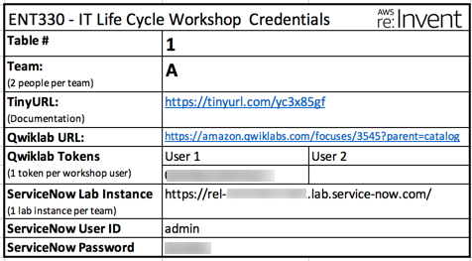
Credential Card
Needs to be updated
MBS
Each Table will have three credential cards per team
Each lab participate will use Qwiklab and receive a token to access
Each team (two people) will share one ServiceNow instance

Slide 8
Don’t Forget to Start Your Lab Environment!

Slide 9
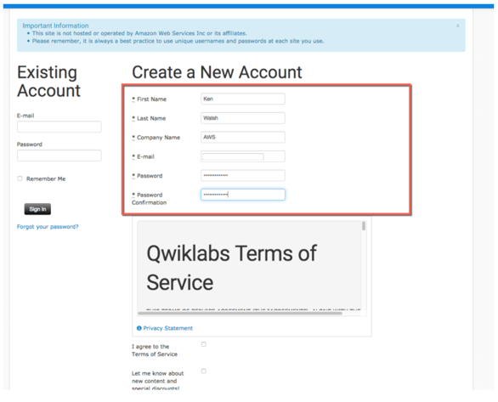
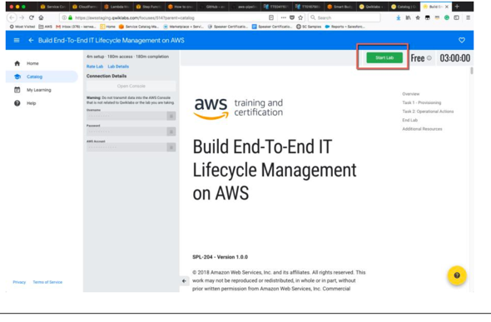
GitHub
Needs to be updated
Saager
ENT330 course registration instructions are on the tiny URL: https://tinyurl.com/yc3x85gf
Lab instructions are in the lab URL. Scroll to step 1 for details on starting the lab
Blue icons in connection details are ‘clipboard’ icons. Click to copy contents

Slide 10
Introduction

Slide 11
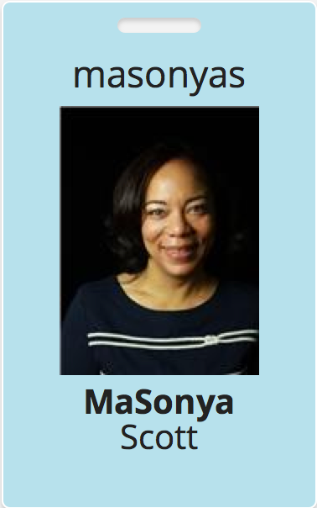
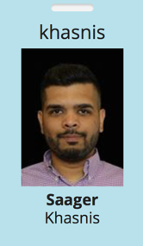
Presenters
Needs to be updated
Saager
MaSonya Scott – AWS Service Catalog Principal Business Development Manager based in Atlanta, GA. Joined AWS in December 2016. Experience in operations and ITSM consulting. Currently serves as the one of the liaisons between AWS and ServiceNow.
Sagar Khasnis – AWS Marketplace Solutions Architect based in Seattle, WA. Need Quick Blurb

Slide 12
What to Expect from this Lab Workshop
Needs to be updated: MBS Add security context
By the end of this session you should be able to:
Articulate the importance of Cloud operations, and the right Cloud operating model, to achieve sustainable adoption of AWS
Understand AWS Management Tools value proposition to infrastructure operations for our customers
Evaluate the cloud operating model leveraging ServiceNow ITSM tooling scenarios integrated to AWS Management Tools to enhance Cloud Management

Slide 13
IT Lifecycle Overview

Slide 14
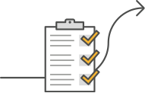


Goals in the Cloud: Speed & Security
Following best practices for security and compliance
Deploy AWS services quickly
while
Notes:
Across the board, we’ve found that when customers move to the cloud, they want two contradicting things: to deploy AWS products securely, all while giving end users access to deploy these products quickly. This is a common paradigm: striving for a balance between security and speed. Companies want to allow their developers to move quickly, to access and deploy any products necessary to get their jobs done. On the other hand, granting end users full access to all products on AWS can leave the firm exposed to security risks. On top of that, all those deployments are hard to track.

Slide 15
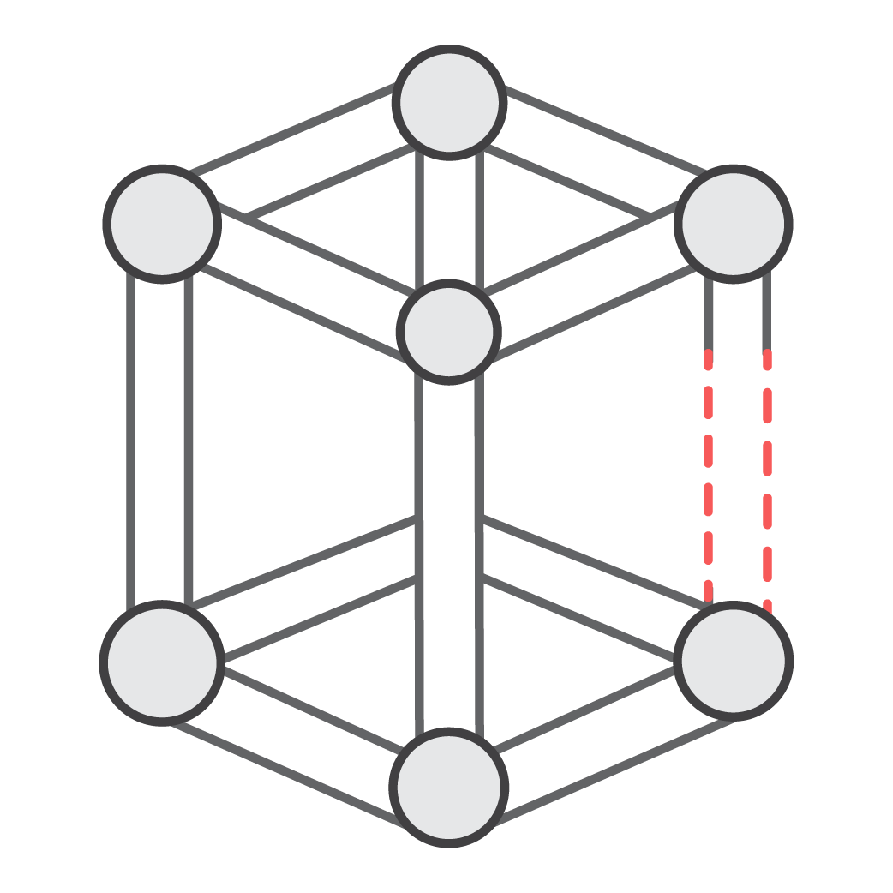

The Challenge
Future
Value
Traditional
Operations
THE GREAT STALL
Today
Foundation
Project
Time
Notes:
Trying to apply traditional operations models and processes can actually devalue cloud and if coupled with insufficient knowledge of cloud architecture principles can ultimately lead to lowest common denominator. Whilst it’s fast to deploy services if the associated operations processes don’t adapt then business will get frustrated with the lack of agility and may become despondent towards cloud.
To address this we need to create cloud MVP Operations model to be implemented as the same time as the rest of the foundational services.

Slide 16



What Operating Models do we recommend?
Sustain
“Traditional Ops”
Optimize
“CloudOps”
Grow
“DevOps”
Engineering
Operations
Engineering
Operations
Engineering
Operations
Dev Team /
COTS
Cloud Operations
Dev Team /
COTS
DevOps
Teams
App
Ops
Applications
DevOps
Applications
DevOps
Applications
DevOps
ITSM
ITSM
ITSM
Cloud Platform Engineering
Cloud
Platform
Engineering
Platform
Ops
Platform
Platform
Platform
Cloud Platform Engineering
Transitional
Strategic
Strategic
Notes:
Sustain / Traditional
Development Teams develop, build, and package software for release by operations
Cloud Engineering may or may not be present to codify infrastructure standards and artifacts for release by operations
Operations May leverage either CCOE products and services to deploy and manage applications and infrastructure in production
Operations may be a 3rd party MSP, or an existing on-prem operations team.
Optimize / CloudOps
Development Teams develop, build, and package software for release by operations
Cloud Engineering codifies infrastructure standards and artifacts; provides enabling services for operations and security.
Cloud Operations: provisions and configures infrastructure from standard CCOE products and services; leverages CCOE products and services to manage applications and infrastructure in production
Grow / DevOps
Development Teams leverage CCOE products and services to:
Develop, build, and package software for release
Provision and configure infrastructure from standard CCOE products and services
Leverages CCOE products and services to deploy and manage applications and infrastructure in production
Cloud Engineering codifies infrastructure standards and artifacts; provides enabling services for operations and security.

Slide 17

Service Catalog: Simplified Provisioning
Product
Portfolio
Constraint
JSON, YML or Terraform
IT service or resource
Admins create collections of products
Security, governance and deployment controls
Service Catalog Administrator
Service Catalog End User
Provisioned products
Products list
Users can update or perform service actions
User see which products they can launch
Notes:
This is a simpler experience for the user. Whether it is the right virtual machine, the right VPC or the right multi-tier solution, they can all be added to the user’s product list such that when the user logs into their AWS console, they only see products, services or solutions that have been approved for their personal use. Furthermore, the user doesn’t need to worry about leaving their company open to a potential data breach, or be concern about meeting the company’s policies or ensuring the use of this product meets budget requirements, because all these concerns can be pre-configured and checked ahead of time. …and users can take advantages of these benefits, even if they do not have direct access to AWS. In other words, they can deploy and use products, services and/or multi-tier solutions that run on AWS, without having direct access to AWS itself. This is a very powerful paradigm that helps organizations capitalize on cloud velocity, strengthen the overall security posture, and reduces time of cloud adoption.

Slide 18















Connect ServiceNow to AWS Services
Validate SNS Scoped app is in scope
4
AWS resource info and event triggers are published to ServiceNow incident management
Amazon CloudWatch
AWS Config
Amazon EC2
Amazon S3
Amazon RDS
Amazon VPC
Amazon SNS
Amazon Machine Learning
AWS IoT
AWS Mobile Hub
Amazon
EMR
Amazon
SQS
Amazon
WorkSpaces
1
ServiceNow users browse and request AWS services
2
Catalog administrators procure, publish, and govern AWS services
3
Operators monitor and manage AWS services

Slide 19




Benefits
Needs to be updated
MBS
Accelerate AWS Adoption: Minimize ServiceNow admins need to ramp skills on AWS admin actions and vice versa.. increases speed to market
Streamline Provisioning: Enable developers to request and build cloud products in the same catalog they order mobile phones, laptops and other IT services.
Agile Governance: You can proactively govern the environment, enforce mandatory configurations and leverage scenarios where you would launch a resource on AWS (e.g. a security group).
Control Costs: Enforce specific AWS resource types or sizes in a given environment to control costs.
Limit Access: Grant access to developers to provision AWS resources without giving them access to the underlying AWS services such as Amazon EC2, Amazon S3, Amazon RDS, etc.
Connector Supported on Multiple ServiceNow Releases: London, Kingston, Jakarta

Slide 20
IT Lifecycle Workshop

Slide 21

IT Lifecycle Workshop Tasks
1
Provisioning
2
Operational Actions
3
Self-Service
4
Incident Management
AWS

Slide 22
Task #1 – Provisioning
Needs to be updated
Pre-configured Items
AWS Service Catalog portfolio
Amazon EC2 product
Amazon WorkSpaces product
1
Provisioning
Lab Tasks
Review your Service Catalog portfolio
Perform a test run

Slide 23




Task #1 - Provisioning
Needs to be updated
Need to show IAM permissions as a step
1
View EC2 product
2
View Workspaces
product
SC Administrator
View the access granted to end users
3
View TagOption
3
5
AWS
Service Catalog
6
End users
4
Launch EC2 product
View launch constraint
role

Slide 24
Task #2 – Operational Actions
Needs to be updated
Lab Tasks
Set up your Service Actions library
Add start/stop actions to Amazon EC2 product
Test Self-Service actions
2
Operational Actions

Slide 25
Task #2 – Operational Actions
1
Set up Service Actions Library
2
Associate Service actions
with Amazon EC2 product
SC Administrator
Launch Amazon EC2 product
3
Open launched Amazon EC2 product
3
AWS
Service Catalog
4
Stop Amazon EC2 instance
End users
Start Amazon EC2 instance
5
role
(optional)

Slide 26
Tasks 1 & 2 Reminders
Is this need since we are going into GitHub
Step | Reminder
General | Switching roles using “Connection Details” for steps 5, 18, 37, 52… is instructionally required. Note: Previous browser tabs with different roles will align to the most recently switched browser tab’s role.
Step 5 | Switching roles: “Connection Details” values may look similar SwitchRoleSCEndUser vs. SwitchRoleSCAdmin
Step 7 | Search for “Service Catalog” if not shown in the AWS Console Services menu
Step 23 | Product version names are unique to each student/environment. “My-EC2-instance” can be used once. Subsequent product names should different.
Step 30 | Additional instances may running in the simulation.
Step 50 | “Associate an Action” is right-aligned to the view port. Viewing screen size determines how far the link is located
Step 64 | In the Service Catalog Provisioned Product List, click the “Terminate Provisioned Product” action within the “My-EC2-instance” product box menu.

Slide 27
Checkpoint

Slide 28

IT Lifecycle Workshop Tasks
1
Provisioning
2
Operational Actions
3
Self-Service
4
Incident Management
AWS

Slide 29
Task #3– Self-Service
Pre-configured Items
AWS Service Catalog scoped app
AWS Service Catalog scoped app roles
A catalog of products in AWS Service Catalog
3
Self-Service
Lab Tasks
Configure AWS account in AWS Service Catalog scoped app in ServiceNow
Validate Configuration

Slide 30
Task #3– Self-Service
Needs to be updated add EC2
1
AWS
Service Catalog
Connect AWS Service Catalog
with ServiceNow
SC Administrator
Connector sends the request from ServiceNow to AWS Service Catalog
3
(optional)
2
Order Amazon WorkSpaces Desktop
End users

Slide 31
Task #4 – Incident Management
Pre-configured Items
SNS scoped app (in ServiceNow)
SNS Topic (in AWS)
AWS Config rule (in AWS), CloudTrail
Amazon CloudWatch Events rule
4
Incident Management
Lab Tasks
Subscribe to an SNS topic from ServiceNow
Validate incident by launching an EC2 product

Slide 32




Task #4– Incident Management
1
Add ServiceNow as a listener to Amazon SNS topic
Create incident
in ServiceNow
6
Amazon CloudWatch
Amazon SNS
Evaluate / Re-evaluate
rule
Compliance Change triggers Amazon CloudWatch Events rule
3
5
ConfigLambdaFunction
4
Launch an EC2 instance via ServiceNow
2
Report Results
Report Results
Amazon EC2
AWS Config
Events event
rule

Slide 33
Tasks 3 & 4 Reminders
Is this needed
Step | Reminder
General | ServiceNow lab instance instructions are located in the PDF linked in step #66. ServiceNow lab instances contain a single “-“ (dash) between “service” and “now” in the primary domain name for the lab URLs i.e. https://rel-nov20shm469-097.lab.service-now.com/
Step 3.3 | If copying & pasting is used from the PDF, step 5 specifies “order_aws_sc_products”. The available role in the ServiceNow instance is “order_aws_sc_product”, without the “s”.

Slide 34
Wrap-Up

Slide 35
Outcomes
Delivery of Production Systems by Multi-Disciplinary Teams
Improve Operational Efficiency
Service Template Consumption
Consistent Framework for Overall Adoption and Acceleration
Enforce Compliance
Enhance Customer Satisfaction

Slide 36
Call to Action
Needs to be updated
MBS

Slide 37
Resources
[Launch Announcement] SC ServiceNow Connector
[BLOG] Jeff Barr-AWS Service Catalog Connector for ServiceNow
[BLOG] Install AWS SC Connector for ServiceNow
[Questions] SC BD Team: aws-sc-bd@amazon.com

Slide 39
MaSonya Scott (masonyas@amazon.com)

